Slide 1
The TOEFL® Test
An Update from ETS
Becas Talentia
April 8, 2011
Jose Santiago
Director, Client Relations
Educational Testing Service

Slide 2
The TOEFL® Test Difference

Slide 3
What is the TOEFL Test?
The Test of English as a Foreign Language™ measures the English language proficiency of non native speakers using an academic context

Slide 4
TOEFL® Test Overview
More than 25 million test takers since 1964
Most widely available academic English-language test in the world
Administered in over 4,500 certified test centers in more than 165 countries
Most widely recognized
More than 7,500 institutions, professional bodies, immigration authorities and scholarship agencies worldwide recognize and accept TOEFL scores

Slide 5
45 iBT TOEFL centers in 19 cities
Almeria | Palma de Mallorca
Barcelona | Pamplona
Mataro | Salamanca
Cordoba | Santiago de Compostela
Gijon | Sevilla
Granada | Burjassot
Leganes | Murcia
Madrid | Valencia
Pozuelo de Alarcon | Zaragoza
Oviedo

Slide 6
The TOEFL iBT™ Test (Internet-based test)
Four language skills: Reading, Listening, Speaking, Writing
100% academic
Emphasizes communicative English
Integrated questions
Reliability coefficient 0.95

Slide 7
The TOEFL iBT™ Reading Section
3 to 5 reading passages (60 – 100 min)
Reading passages approximately 700 words long
Followed by 12 to 14 questions for each reading passage
Includes multiple-focus passages
(e.g., cause/effect, compare/contrast)
Glossary feature to define words not commonly used
Review feature

Slide 8
The TOEFL iBT™ Listening Section
4 to 6 lectures - 60 – 90 minutes
2 or 3 with classroom dialogue
3 to 5 minutes long
Each has 6 questions
2 or 3 conversations with 2 speakers
2 to 3 minutes long
Each has 5 questions

Slide 9
The TOEFL iBT™ Speaking Section
Reflects the kind of academic speaking you’ll need to do at a college or university
Six different tasks – 20 minutes
Independent speaking
Speaking about familiar topics
Integrated speaking
Speaking about campus situations
Speaking about academic course content
Responses scored by 3-6 different raters
who do not know the test taker

Slide 10
The TOEFL iBT™ Writing Section
Independent writing task
30 minute essay
Response based on personal experience or opinion
Integrated writing task
Reading/Listening/Writing
Short academic listening and reading material
20-minute response
Typing is required
Each response scored by 2 different raters
who do not know the test taker

Slide 11
Scoring Sets the TOEFL® Test Apart
Fair testing with unbiased, objective scoring
The TOEFL test separates the testing site from the scoring process to maintain score integrity
Raters see and hear worldwide responses, not just from one country
Raters do not know the examinee

Slide 12
Scoring Sets the TOEFL® Test Apart
Fair testing with unbiased, objective scoring
TOEFL uses multiple raters for speaking and writing
Increases test reliability
Speaking section: Six tasks
Three to six human raters
Writing section: Two tasks
Two human raters
Two automated ratings

Slide 13
Innovation in Scoring
The TOEFL® program uses the e-rater ® automated scoring engine in a limited and responsible way for the Writing section
Independent writing task:
one human rater + one automated rating
Integrated writing task:
one human rater + one automated rating
Combines the judgment of humans for content and meaning and the consistency of automated scoring for linguistic features

Slide 14
TOEFL iBT™ Score Scale
Four skill scores
Reading 0-30
Listening 0-30
Speaking 0-30
Writing 0-30
A total score: 0-120

Slide 15
Official TOEFL iBT™ Score Report

Slide 16
New Developments Faster Scores
Faster score turnaround
Scores are now available to test takers in two weeks or less
Further reductions planned
Test takers now notified via e-mail that their scores are available online
Scores are sent weekly to score users receiving TOEFL scores electronically or via CD-ROM
Official paper score reports are sent to score users three times per week

Slide 17
TOEFL Services

Slide 18
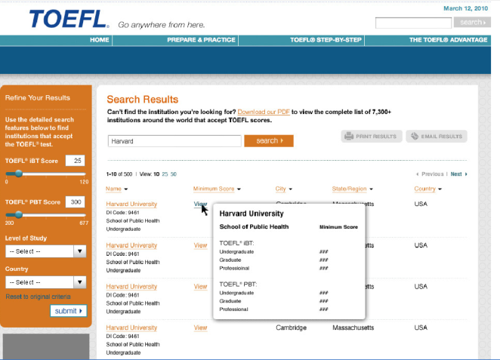
The Advanced TOEFL® Search
Advanced search provides an institution’s score requirements and program information

Slide 19
Resources for Learners
Free TOEFL iBT Test Sample Questions
Includes questions from all four sections of the test
Includes Speaking and Writing sample responses
TOEFL iBT Sampler: www.toeflgoanywhere.org
More free sample questions, included with registration for the TOEFL iBT test
TOEFL iBT Tips: www.toeflgoanywhere.org
Free guide to the test with study tips, scoring rubrics, test section overviews, and more

Slide 20
Resources for Learners
Lexile Measures www.Lexile.com/TOEFL
Match TOEFL iBT™ reading scores to Lexile® measures
Find books of interest at the appropriate reading level
TOEFL® Practice Online (available at the ETS Store www.ets.org/store)
Simulates TOEFL iBT testing experience
Provides instant scores and performance feedback
The Official Guide to the TOEFL® Test, 3rd Edition
Paperback book and CD or e-book formats with test preparation tips, strategies and sample questions
Institutional discounts: orders of 50 or more receive 50% discount(contact TOEFLNews@ets.org)
Pronunciation in English; Idioms in English; and Writing in English (available at the ETS Store www.ets.org/store)
Interactive multimedia programs

Slide 21
TOEFL® Information and Contacts
TOEFL website: www.ets.org/toefl

